Slide 1


Computer Networks X_400487
Lecture 1: Introduction to Computer Networks
Welcome! Lecture starts at 15:30
Lecturer: Jesse Donkervliet

Slide 3
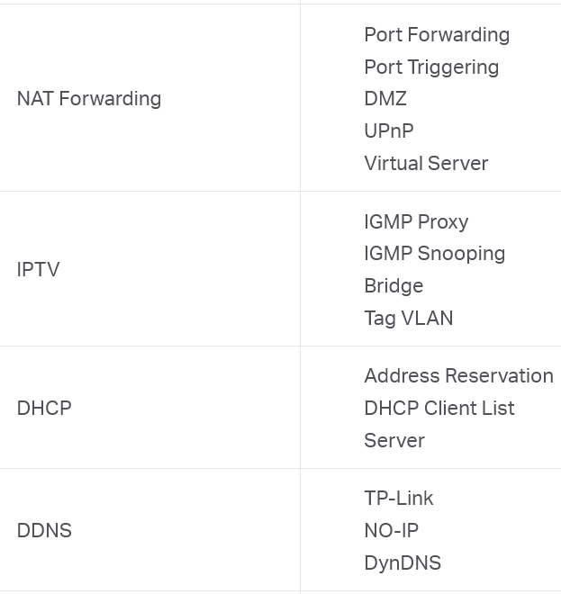
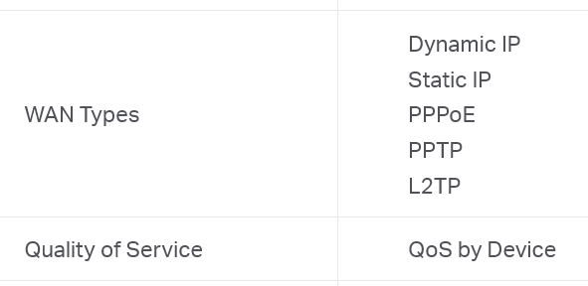
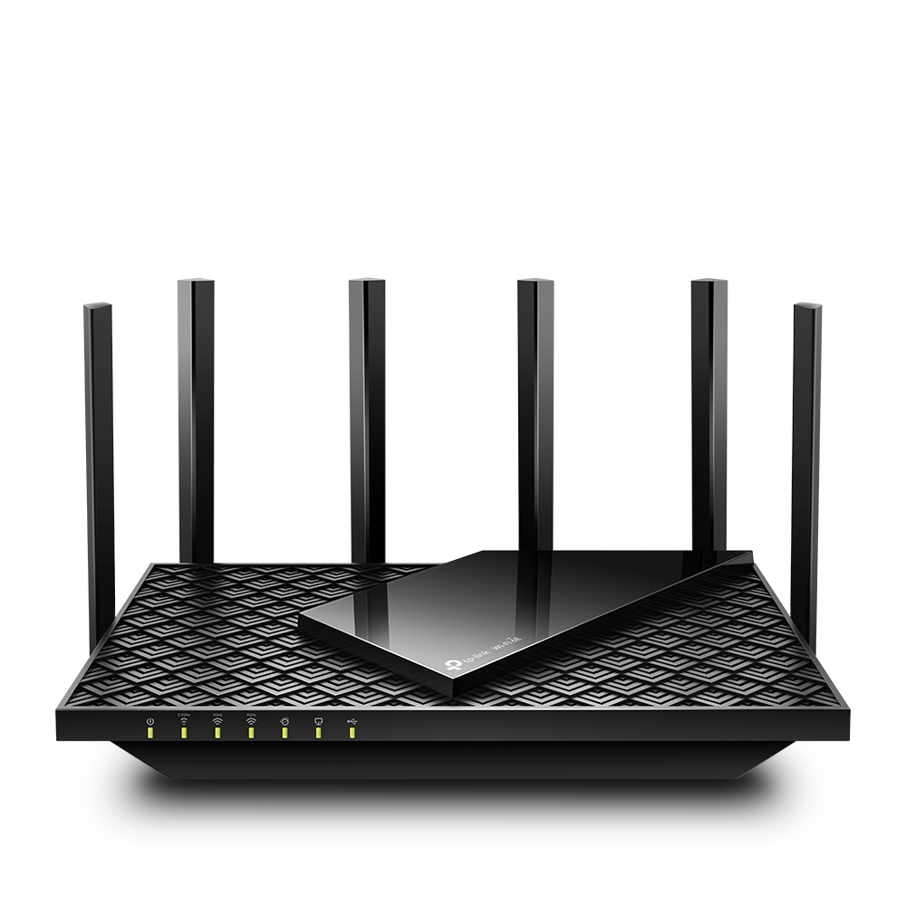
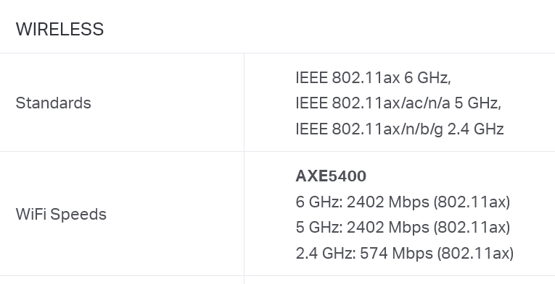
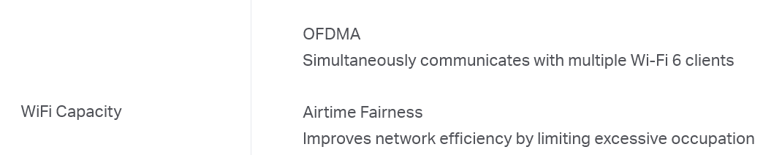
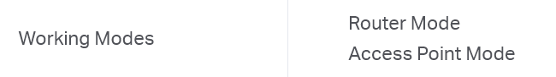
1. After this course, you understand router specifications

Slide 4


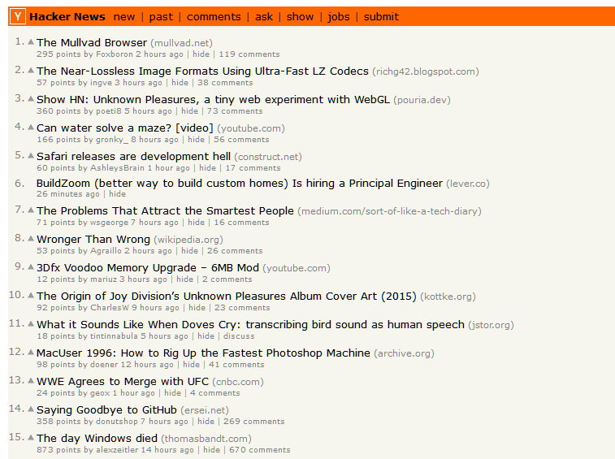
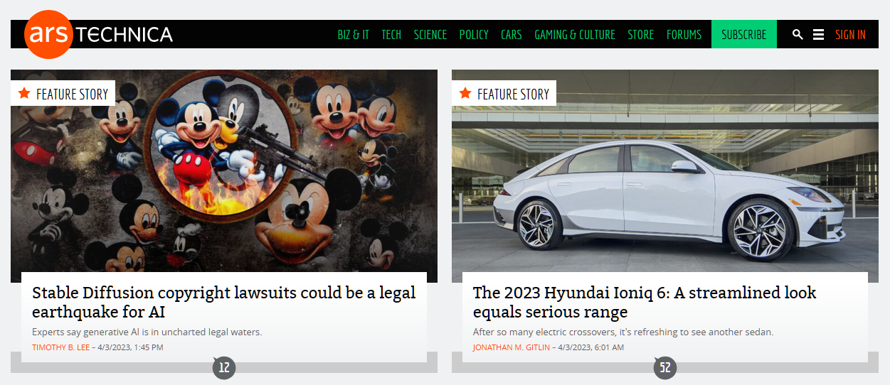
(a) Type address in browser
(b) Browser does magic
(c) You get a Web page
2. After this course, you understand browser magic

Slide 5
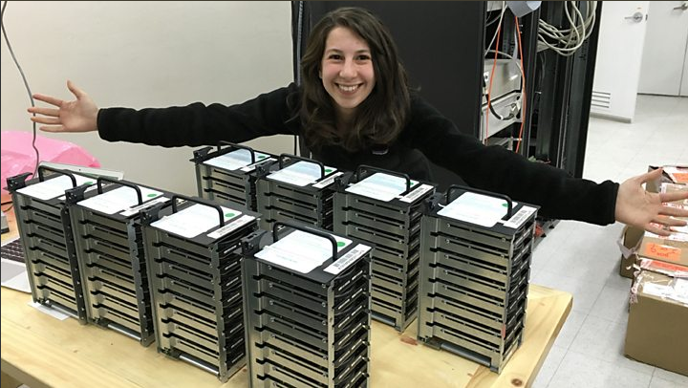


3. After this course, you understand how networks enable new applications

Slide 6
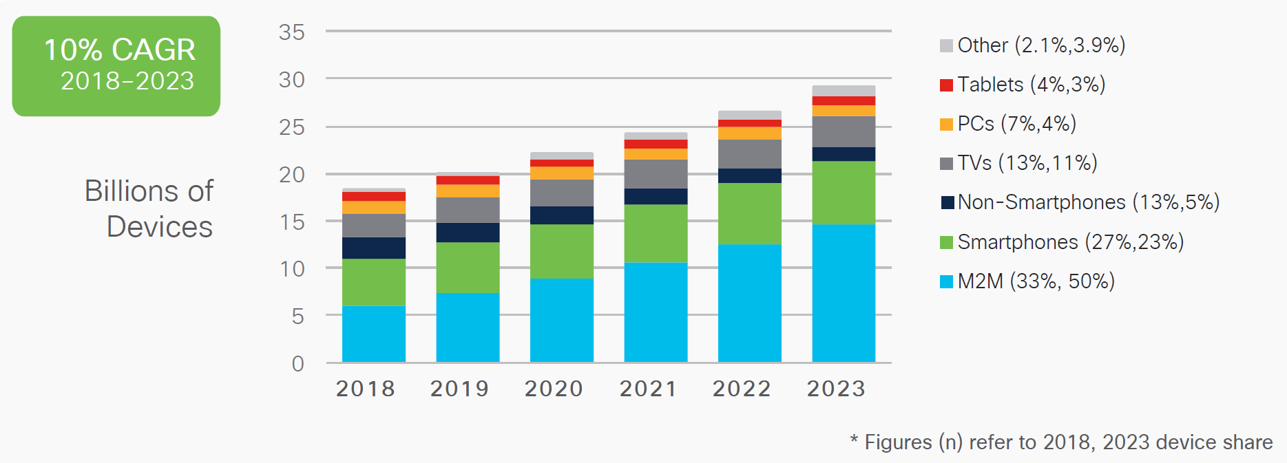
Number of devices connected to the internet
Likely exceeds 20 billion connected devices
Yearly increase of 10%
Q: How much traffic is generated by these users?

Slide 7
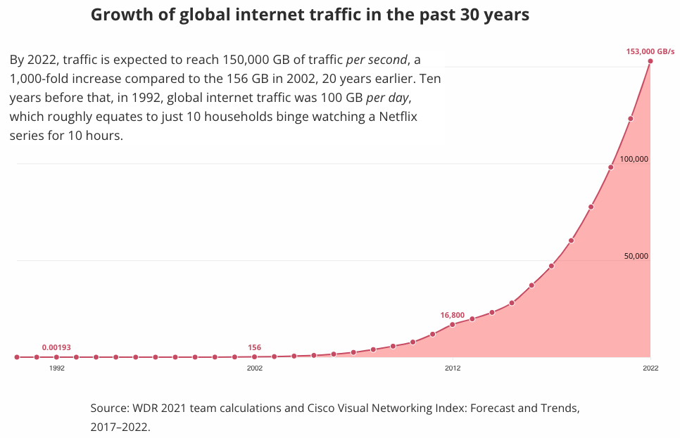
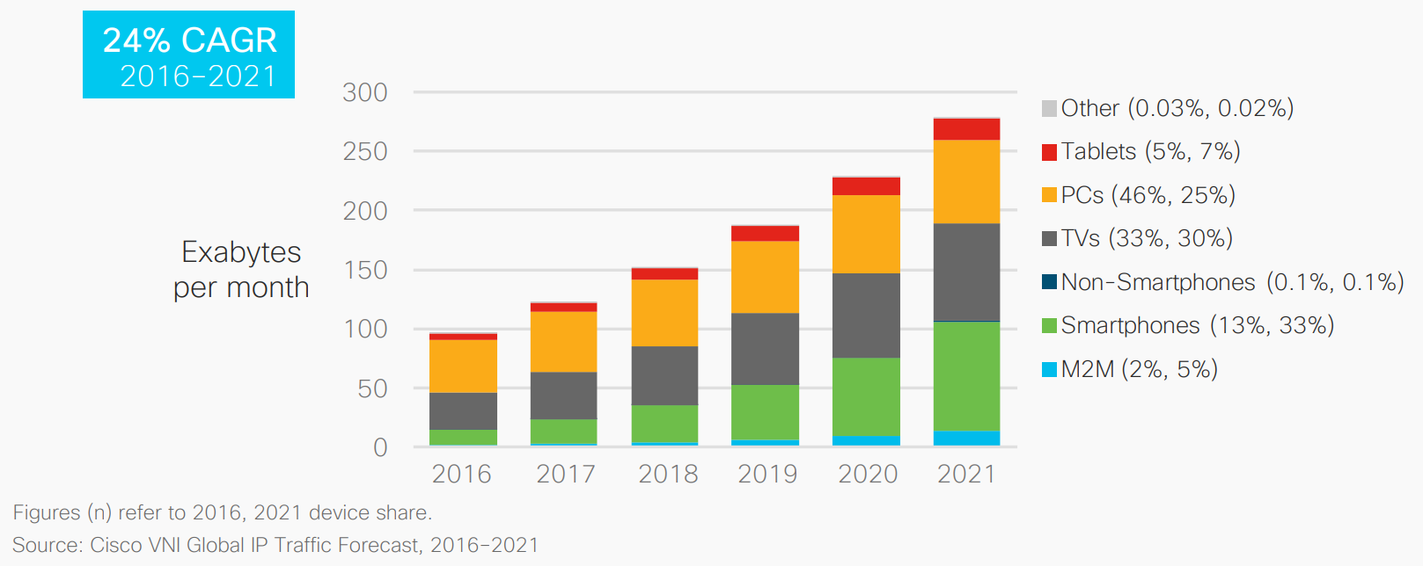
Global traffic
1 Exabyte = 1,000 Petabyte = 1,000,000 Terabyte

Slide 8
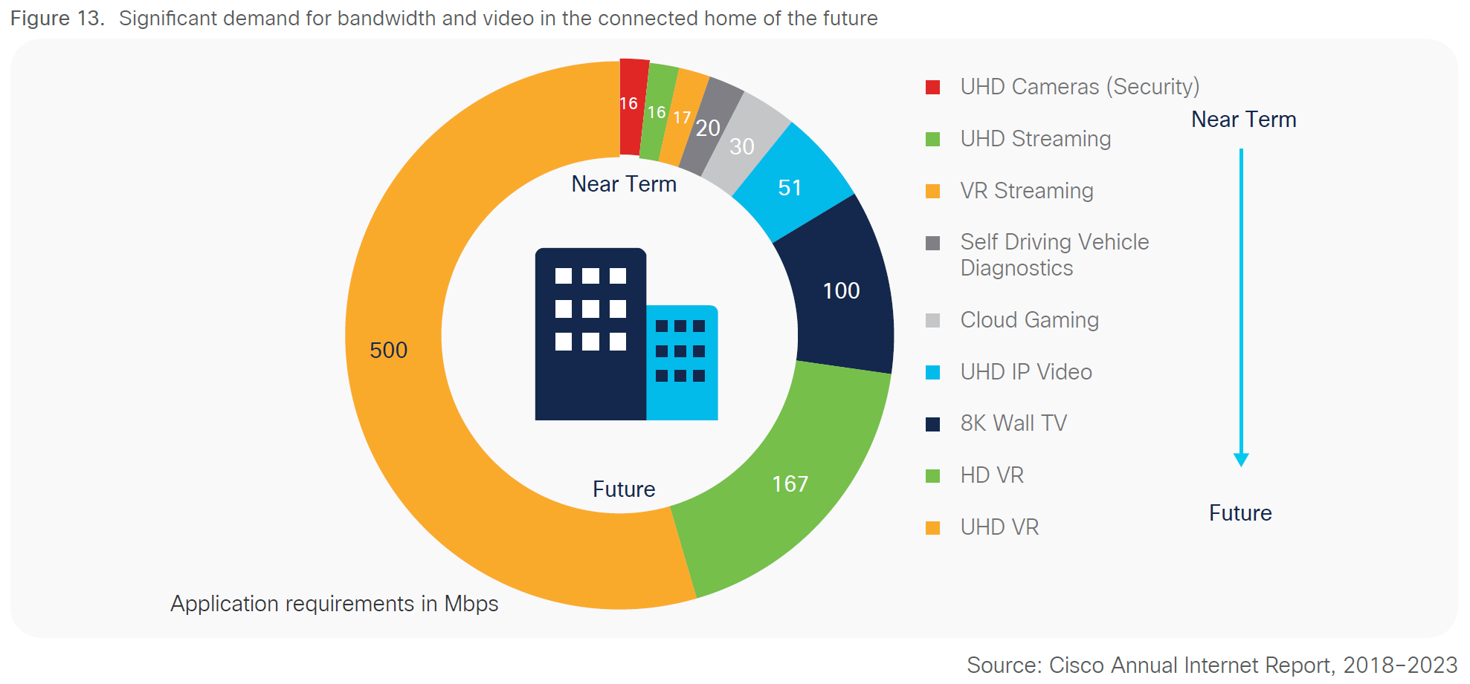
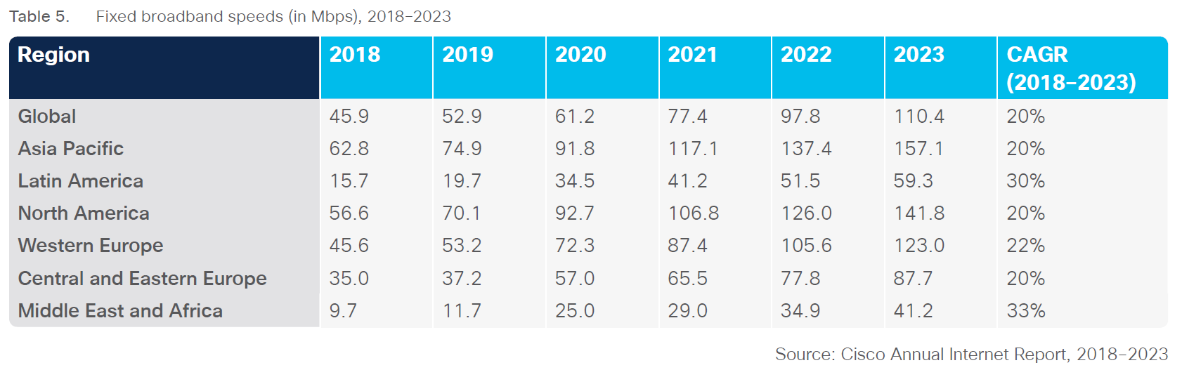

Slide 9

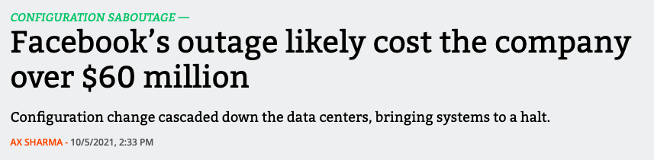


Slide 10
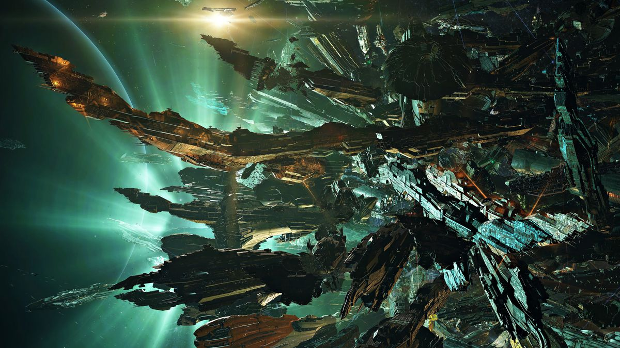

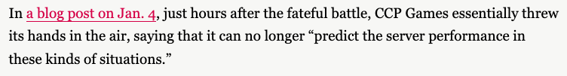
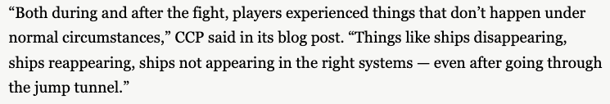

Slide 11
Why are existing systems not good enough?
BUS
Memory
MAR
MDR
Examples of challenges:
Latency is unknown and/or unbounded
Data channels are unreliable
Sharing resources with multiple users
…
Network

Slide 12
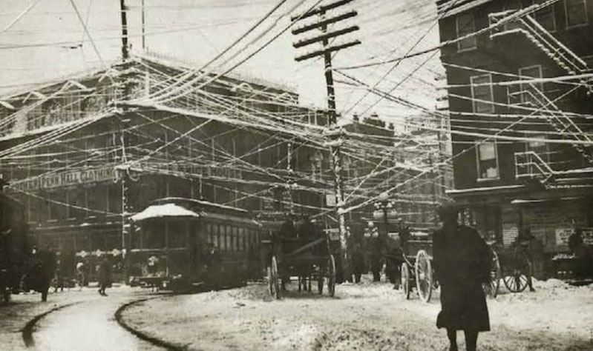
Early telephone system

Slide 13
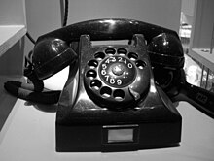
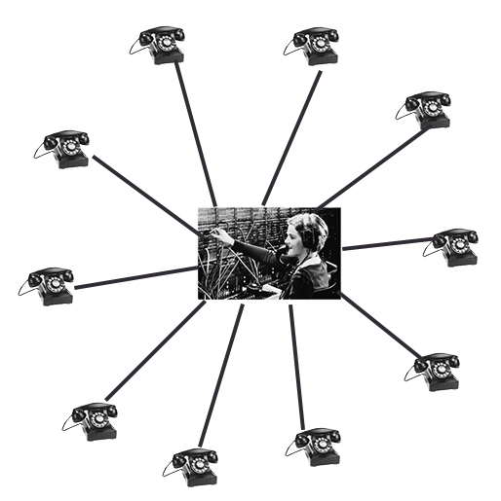
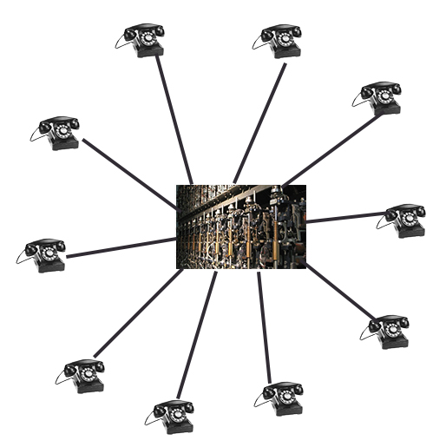
Telephone switching
Human operator
Strowger gear

Slide 14
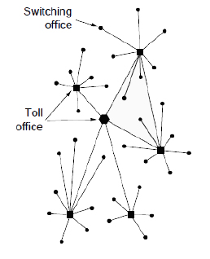
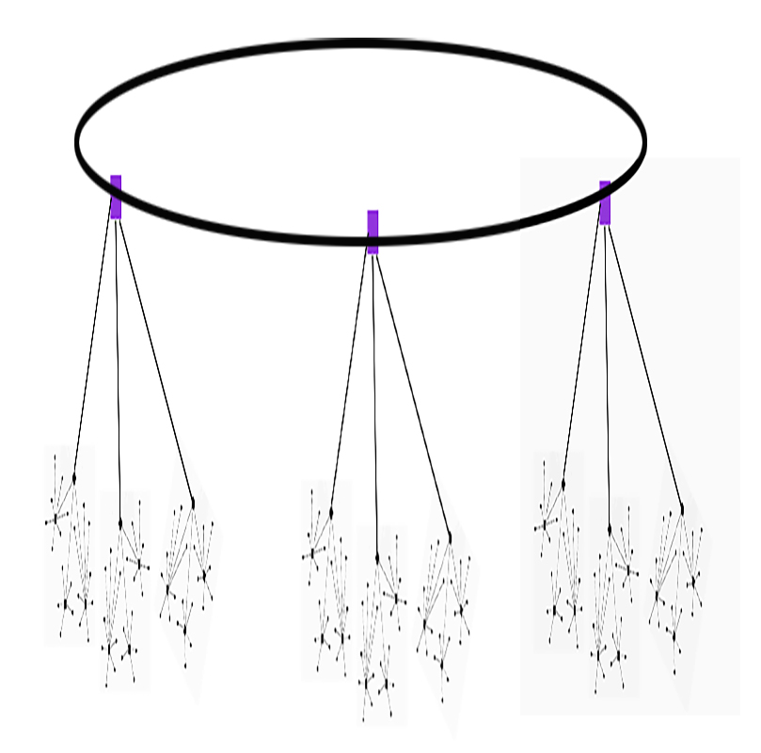
Hierarchical topology

Slide 15
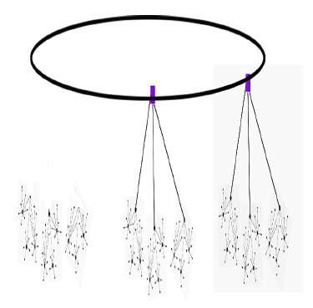
Hierarchical topology

Slide 16
Military is a big fan of resilient systems
US military asked RAND Corporation to design a better system (in 1960).
Paul Baran (RAND employee) designed a fault tolerant network.
Military asked AT&T to build it.
They refused…
Baran’s design was forgotten…
But design improved upon by NPL, built by ARPA.

Slide 17
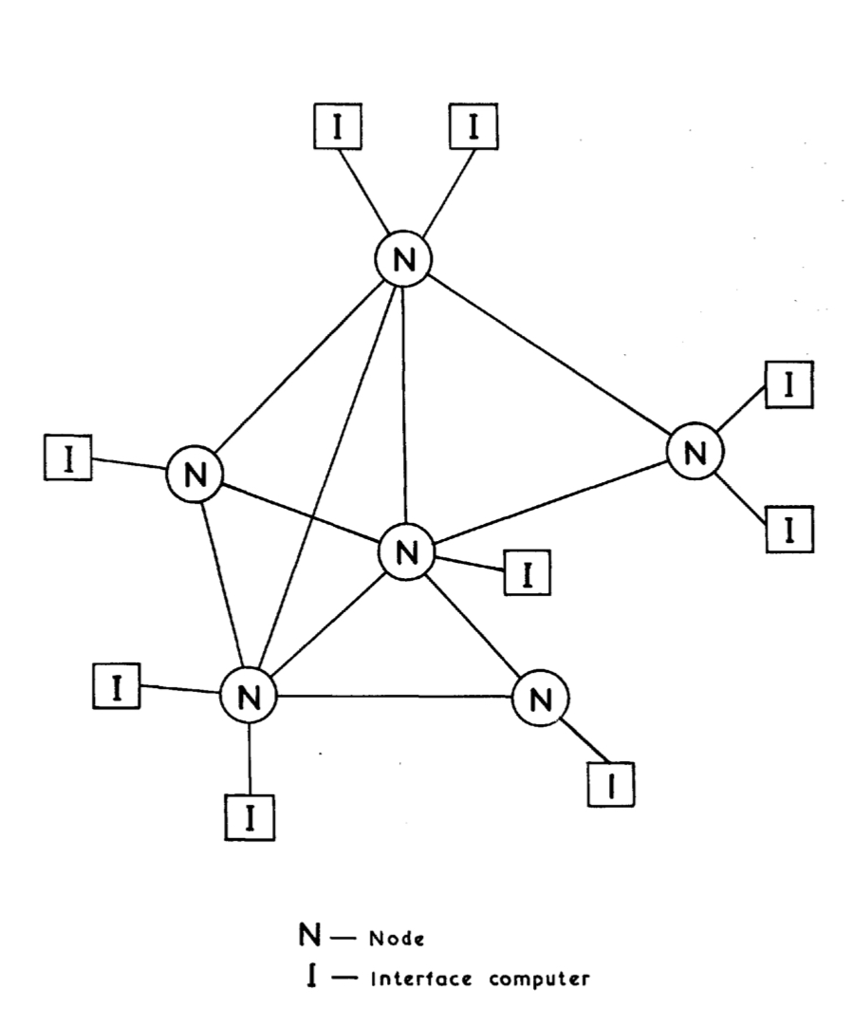
Network designed by the National Physical Laboratory
NPL paper cited Baran but went further
Divided files into chunks called packets
Store-and-forward packet switching network
They did not build a prototype, but described its design.

Slide 18
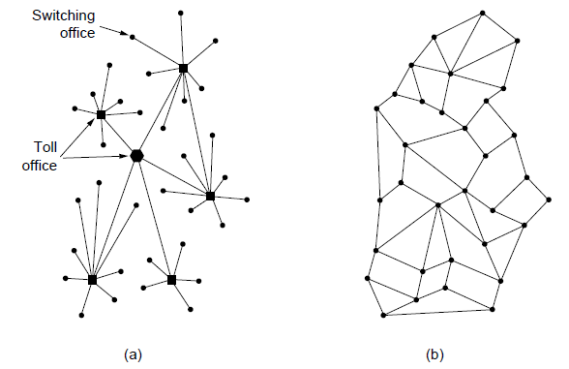
The ARPANET A mesh-structured network

Slide 19
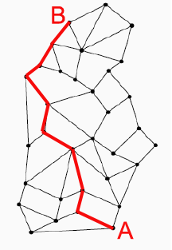
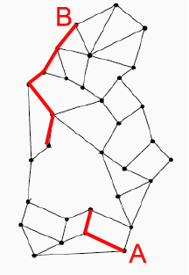
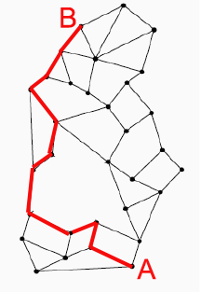
The ARPANET Fault tolerance

Slide 20
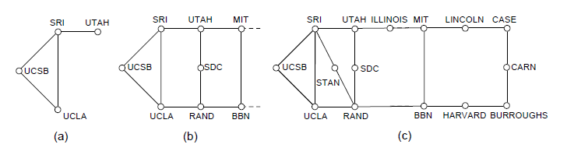
The ARPANET Growth over time
Growth of the ARPANET.
December 1969.
July 1970.
March 1971.

Slide 21
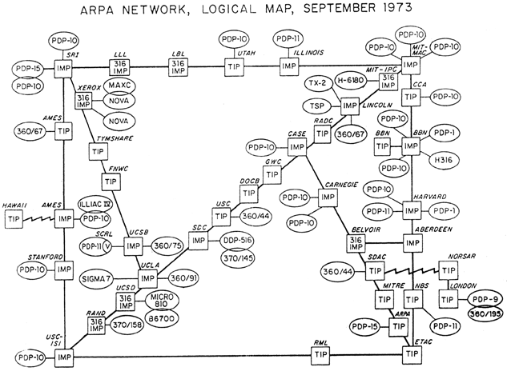
The ARPANET Network state in 1973

Slide 22
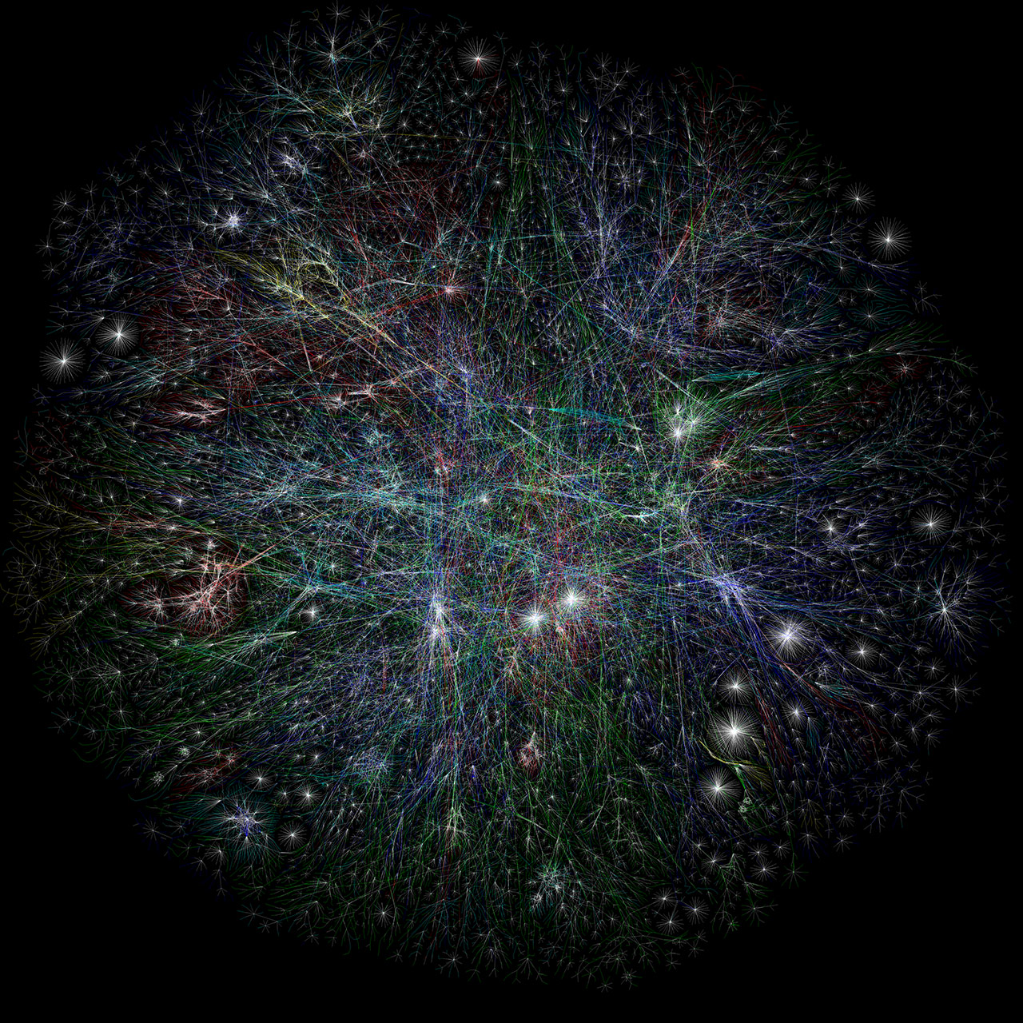

Slide 23

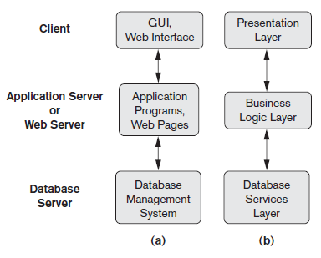

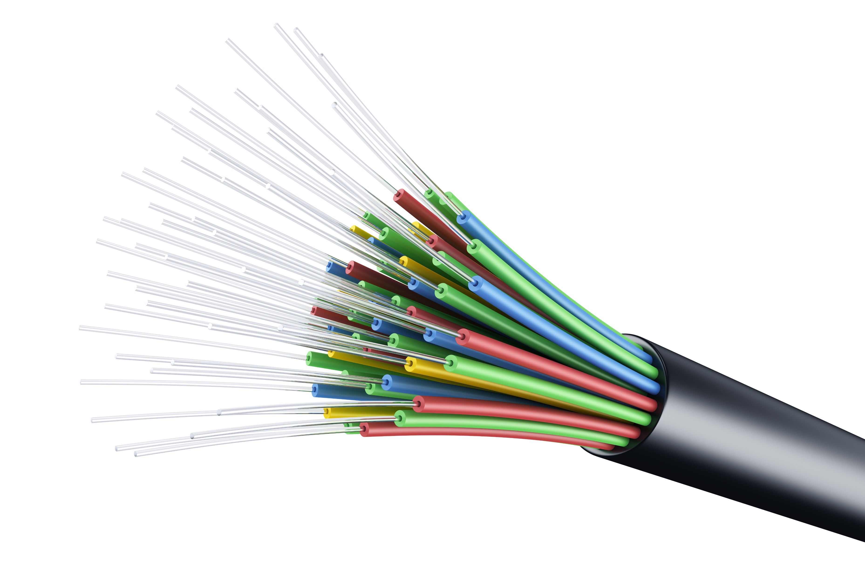

Layered architecture
Q: Why use a layered architecture?
Q: Can you think of another domain that uses layered architectures?
Can be found in…
…computer networks…
…and other domains
Application layer
Transport layer
Network Layer
Data link layer
Medium Access Control
Physical layer
Image from: Fundamentals of Database Systems, Ramaz Elmasri

Slide 24
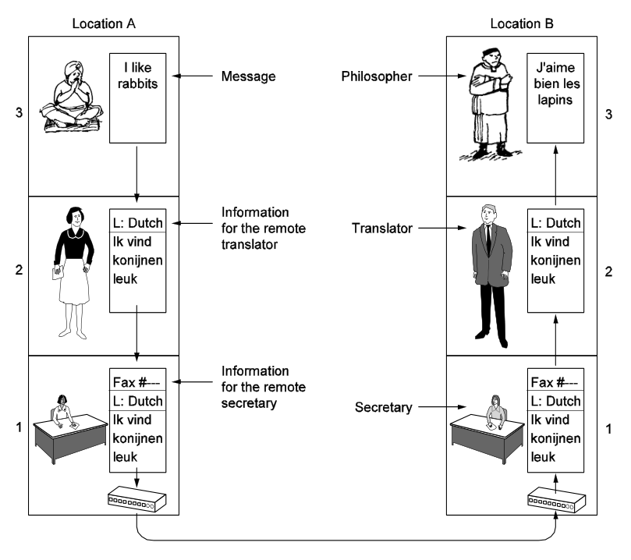
Layered architecture in computer networks: an analogy

Slide 25

Layered architecture in computer networks: an overview
Layer 5
M
M
Layer 4
H
M₂
H
M
M₁
Layer 3
H
T
H
T
Layer 2
Layer 1

Slide 26
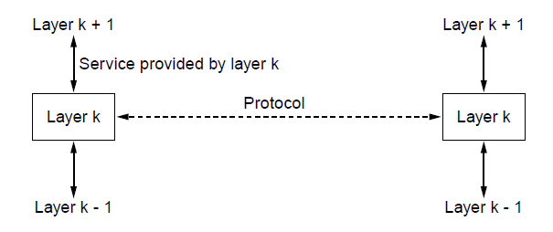
Illusion of direct communication

Slide 27
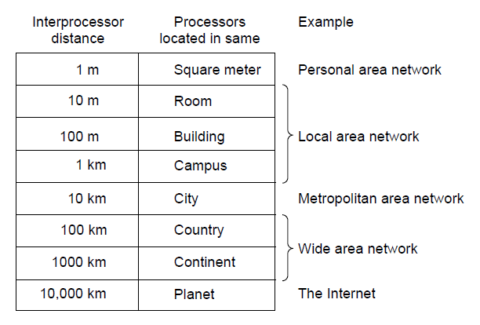
How scale affects networks design
Personal Area Network (PAN)
Example: Bluetooth
Local Area Network (LAN)
Examples: WiFi (802.11)
Metropolitan Area Network (MAN)
Wide Area Network (WAN)
The Internet

Slide 28
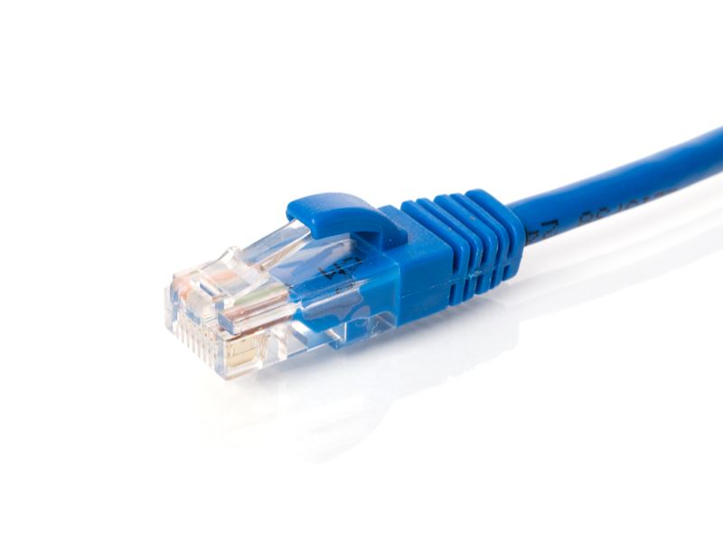
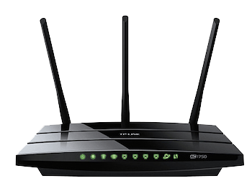
How the medium affects network design
Different frequencies have different
physical properties!

Slide 29
An example protocol
Browser
Web server
HTTP
HTTP protocol
HTTP
TCP
TCP protocol
TCP
IP
IP protocol
IP
Ethernet
Ethernet protocol
Ethernet

Slide 30
Encapsulation in a protocol stack
Browser
GET
HTTP
H
GET
TCP
T
H
GET
IP
I
T
H
GET
Ethernet
E
I
T
H
GET

Slide 31
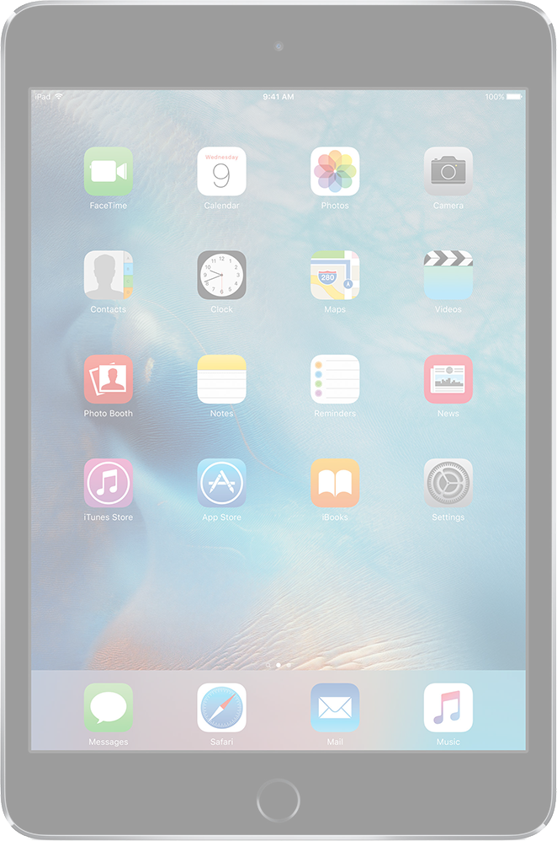


The power of a layered design
Only the lower
level headers need
to change!
Web server
GET
Lower layer header removed.
HTTP
H
GET
T
H
GET
Base station
TCP
I
H
GET
IP
T
I
T
H
GET
I
T
H
GET
8
T
GET
I
H
Ethernet
8
T
GET
E
T
GET
I
H
I
H
New lower layer header added.

Slide 32
Multiple reference models for computer networks
Each models has both advantages and disadvantages.
OSI model
Design by committee.
Strictly separated layers.
TCP/IP model
Widely used in practice.
Low generality.
Poor separation of concerns and interface design.

Slide 33
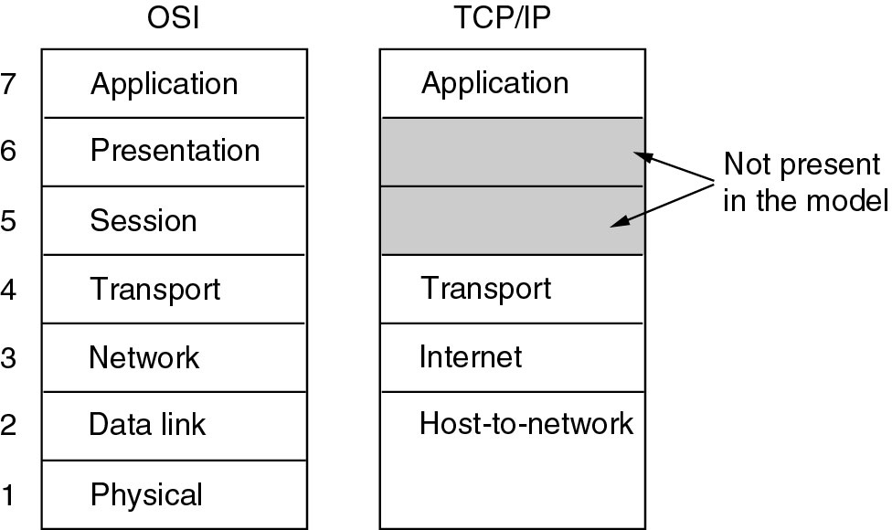
OSI versus TCP/IP

Slide 34
The model used in this course
This Course
The OSI model is well-designed, but layer 5 and 6 are almost empty
5
So we skip them!

Slide 35
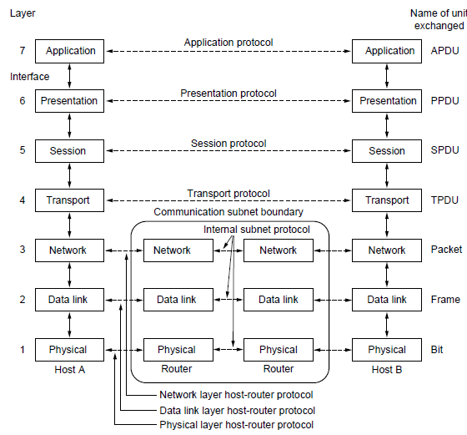
The OSI reference model

Slide 36
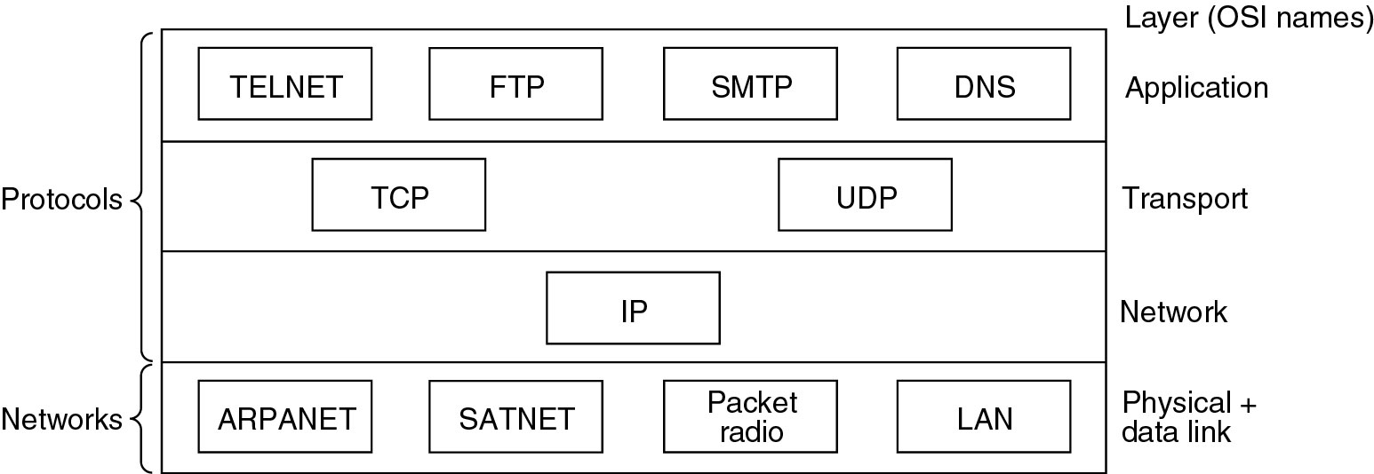
Protocols and Networks from the TCP/IP model

Slide 37
Roadmap of the Computer Networks Course
Lets distributed applications communicate
Application layer
Sends segments from one process to another (over a network)
Transport layer
Sends packets from one machine to another over a network
Network Layer
Data link layer
Sends frames from one machine to another over a single link
Medium Access Control
You are here
Sends bits over a physical medium
Physical layer
Basic principles and course overview
Introduction

Slide 38
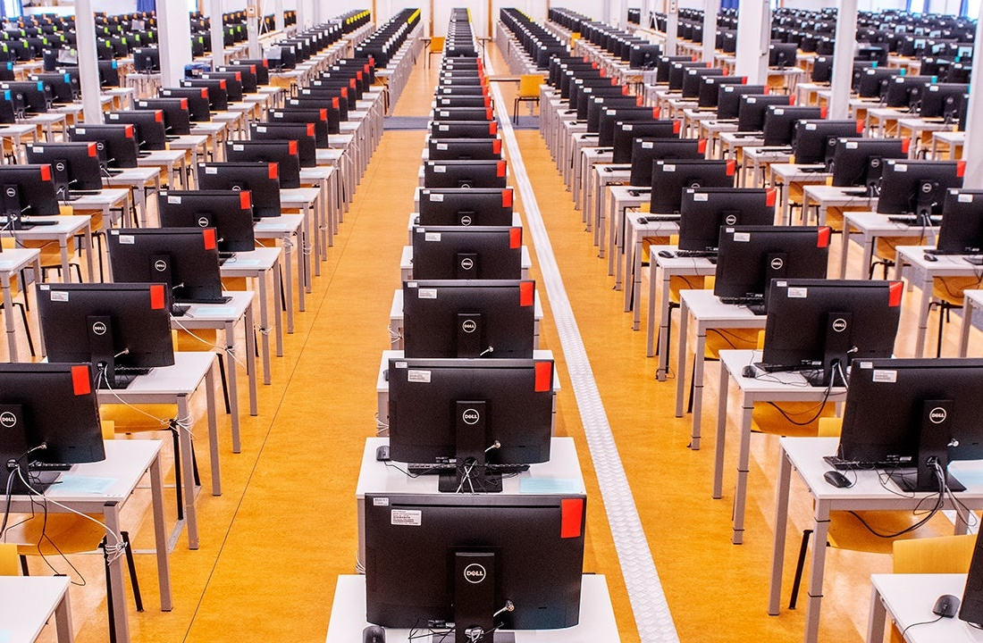
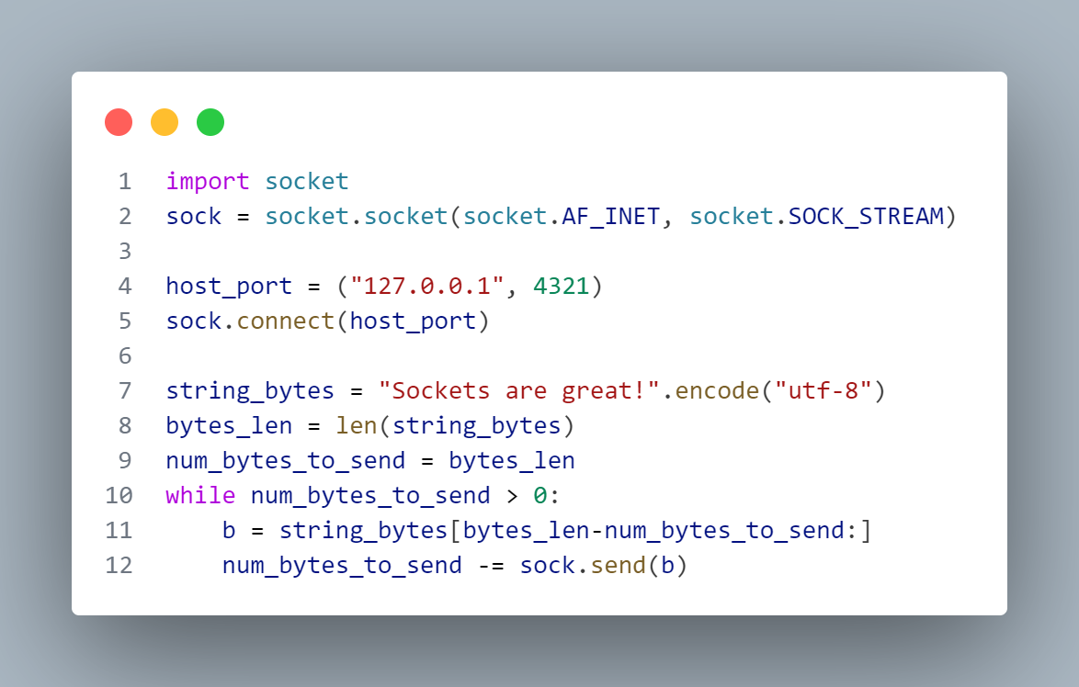

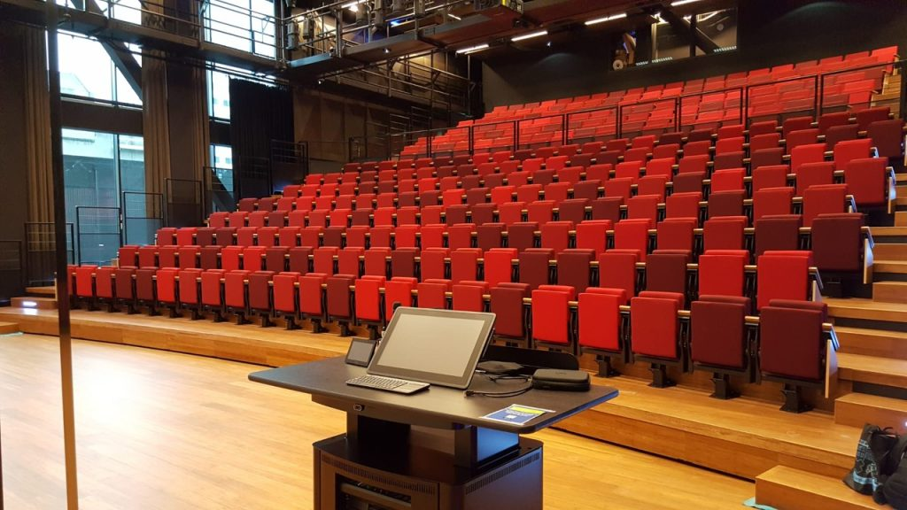
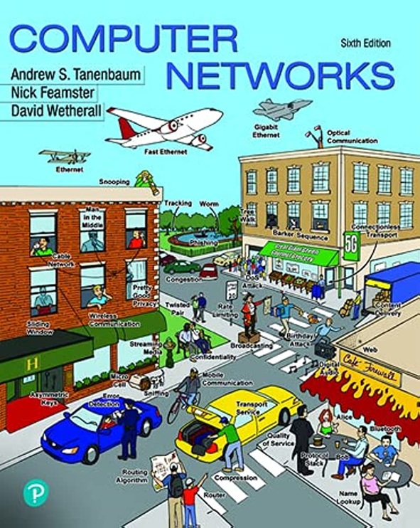
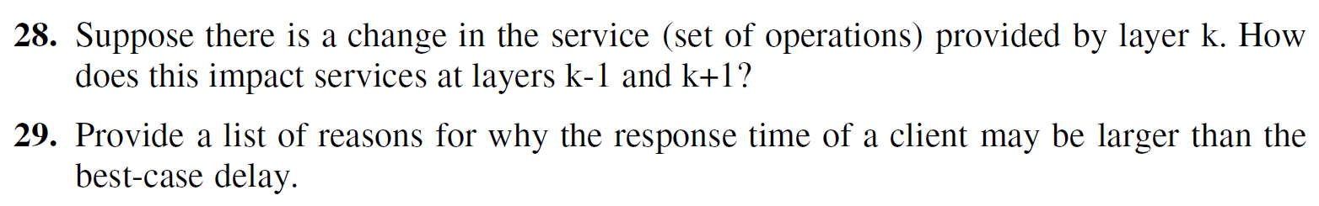





Exam
Lab
Computer Networks
Self-Study
Lectures+Tutorials

Slide 39
Course Activity Overview
Session
Deadline
Mandatory session
Mandatory deadline
Participation path
Midterm Exam
Final Exam
Lectures
Tutorials
Self-Study
Part 1
Part 2
Lab

Slide 40
Course Activity Overview
Session
Deadline
Mandatory session
Mandatory deadline
Participation path
Midterm Exam
Final Exam
Lectures
Tutorials
Self-Study
Part 1
Part 2
Lab

Slide 41
Course Activity Overview
Session
Deadline
Mandatory session
Mandatory deadline
Participation path
Midterm Exam
Final Exam
Lectures
Tutorials
Self-Study
Part 1
Part 2
Lab

Slide 42

How Am I Graded?
$$\text{grade}=\frac{\text{exam}+\text{lab}+\text{in} \text{class}+\text{self} \text{study}}{1000}$$
* You cannot pass the course without passing the mandatory lab assignment.

Slide 43
Lectures
Collect points by:
Giving good answers to questions
Answering correctly questions from the in-lecture quizzes
First quiz is today!

Slide 44
Tutorials: Plenary Practice Sessions
Please use:
Pen
Paper
Do not use:
Calculators
AI Chatbots
Other external tools

Slide 45
Self-Study: Completing Book Exercises
Complete exercises from the book in a group.
Earn more points by completing more chapters.

Slide 46
Self-Study Checkpoints
Graded at two “checkpoints.”
Part 1:
If you successfully completed 2 chapters, you receive +500 points.
Part 2:
If you complete 2 more chapters, you receive +500 points.
If you complete 4 more chapters, you receive +1000 points.

Slide 47
How to Participate in the Self-Study?
Join a Self-Study group on Canvas. Deadline: 12 April.
Submit your Self-Study Plan. Deadline: 12 April.
We recommend starting as soon as possible, and not wait for this deadline

Slide 48
Exams
Midterm (April 22) and Final (May 31)
Computer-based (TestVision)
Multiple-choice questions
Every correctly answered question earns you 300 points
Getting 60% on the exam is not sufficient to pass the course!
Register for the exam on VUnet

Slide 49
Exam Content and Grades
Chapter 1
2
3
4
5
6
7
Midterm
✔
✔
✔
✔
Final
✔
✔
✔
✔
✔
✔
✔
Resit
✔
✔
✔
✔
✔
✔
✔
Final Exam Grade:
max
+
max

Slide 50
Lab
Logistics

Slide 51
Lab
Labs on Wednesdays and Fridays.
Use the Canvas groups page to enroll for the one of the sessions.

Slide 52
Lab
Lab Guide specifies several optional assignments
Assignment 1 and 2 are mandatory
For assignment descriptions, see the Lab Guide on Canvas.

Slide 53
Lab
Collect points by Completing Lab assignments.
Small reward for the mandatory assignments
Larger rewards for the optional assignments

Slide 54
How to Participate in the Lab?
On Canvas, create a CodeGrade group for each assignment
Complete the assignment(s)
Submit the assignment(s) on Canvas
Enqueue during the lab to discuss your solution with a TA
Show and explain your solution for the two mandatory assignments during a lab session in week 4 and week 7 at the latest, respectively
Show and explain your solution for other assignments during a lab session during or in week 8 at the latest
Resit students: please team up with another resit student or work by yourself
Assignments uploaded to Canvas are not accepted without without TA approval obtained during the lab

Slide 55
Lab Logistics
Important:
The assignments may take more than 4 hours to complete.
Getting your assignment approved takes time.
Complete the assignments before the day of their deadline!

Slide 56
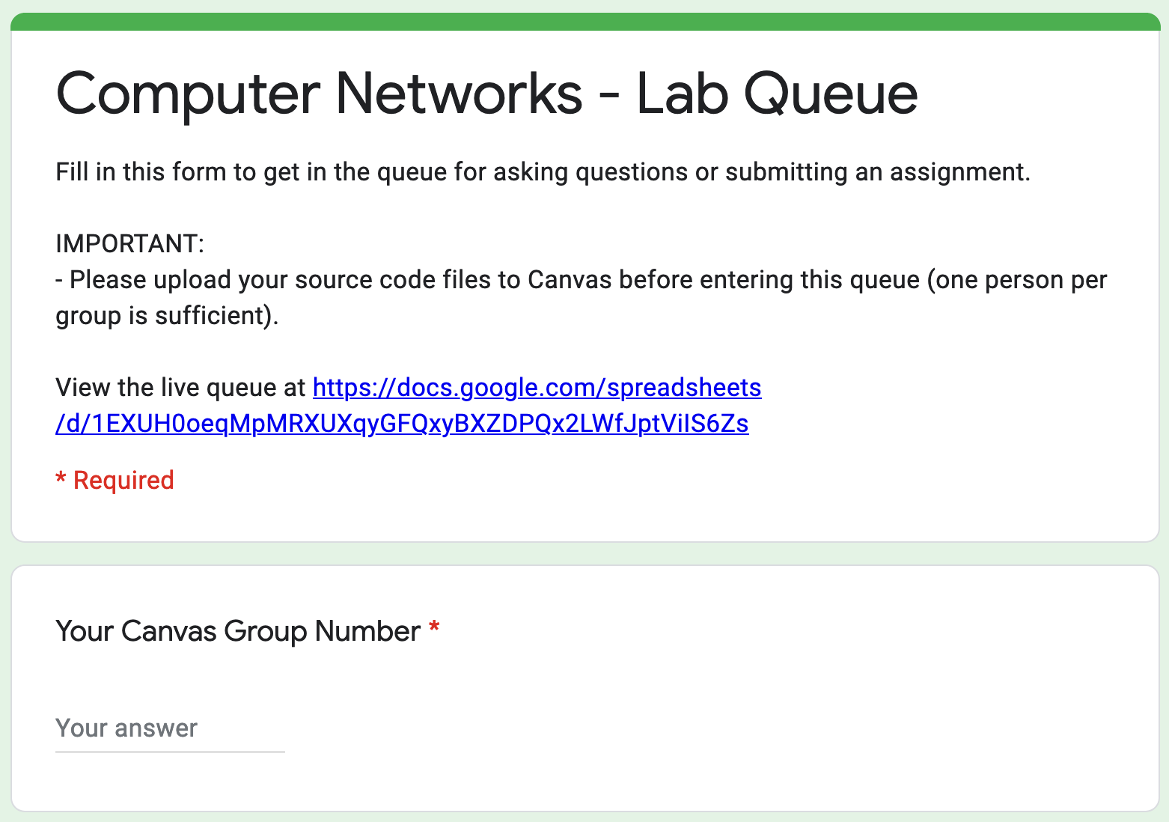
How to Hand in Lab Assignments
Submission System:
Complete assignment.
Upload code/report to Canvas.
Enter Queue ➡
Wait for, and discuss with, TA.
✅ Assignment approved. -or- ❌ Go to step 1.

Slide 57
How to Hand in Lab Assignments
We use a queue, which means First-Come, First-Serve (FCFS)
Important:
Queue closes before the end of the lab session.
Closed queue not a valid excuse for not completing assignments.
Enqueue on time
Do not wait until last session before the deadline

Slide 58
Lab Assignments
Getting Started

Slide 59

Network layer services
Application layer
Sends segments from one process to another (over a network)
Transport layer
Sends packets from one machine to another over a network
Network Layer
Data link layer
Sends frames from one machine to another over a single link
Medium Access Control
Sends bits over a physical medium
Physical layer

Slide 60
Network layer services
Application layer
Sends segments from one process to another (over a network)
Transport layer
This is the service used by your application
What kind of interface does it use?

Slide 61
Socket Primitives in TCP
Socket – create a new communication endpoint.
Used to allow incoming connections
Bind – assign a local address to the socket.
Listen – wait for a connection.
Accept – passively accept an incoming connection request.
Connect – connect to a remote listening socket.
Q: Are we missing something?
Send – send data to the other application.
Receive – receive data from the other application.
Close – close the connection.

Slide 62
TCP Sockets in Python
Network layer protocol
Transport layer protocol
# Import the socket library.
import socket
# Create a new socket.
s = socket.socket(socket.AF_INET, socket.SOCK_STREAM)
# Connect to another application.
s.connect(("hostname", port_number))
# Send bytes.
num_bytes_sent = s.send(buffer)
s.sendall(buffer)
# Receive bytes.
buffer = s.recv(2048)
# Close connection.
s.close()
Application layer
Transport layer
Network Layer
Max number of bytes to receive
Data link layer
Medium Access Control
Physical layer

Slide 63
TCP provides a reliable byte-stream
Q: What does this mean for your application?
The program waits until data is available
It may return an arbitrary number of bytes
s.recv(2048)
H
E
L
L
O
-
F
R
O
M
J
E
S
s.recv(2048)
S
E
\n
W
H
O
\n
s.recv(2048)
S
E
N
D
E
C
H
O
B
O
T
H
s.recv(2048)
E
L
L
O
W
O
R
L
D
\n

Slide 64
Threading Python
# Import threading library.
import threading
# A regular call to print.
print("Hello", "World")
# A threaded call to print.
t = threading.Thread(target=print, args=("Hello", "World"))
# Run target in new thread.
t.start()
# Wait 100ms for thread to finish.
t.join(0.1)

Slide 65

Course Material
Course Material:
Course Slides
Book: Computer Networks, 6th edition, Andrew S. Tanenbaum, Nick Feamster, and David J. Wetherall

Slide 66


Other Computer Networks Books
Peterson and Davie
Kurose and Ross
Available for free at
https://book.systemsapproach.org

Slide 67


How to Study (for this Course)
Or: how we view our own course
Teaching (us) and learning (you)
Our recommendations:
Producing is better than consuming (Do exercises, write programs, quiz yourself, etc.)
Learn how to study effectively
Example books: Make It Stick, How to Become a Straight-A Student

Slide 68























Meet the Team!
+11 others whose picture I could not get in time (sorry!)

Slide 69
How to Contact the Team?
Talk to us at the lab/lecture/tutorial
Expected response time: minutes
Canvas discussion board
Expected response time: hours
Mail us at compnet2024.beta@vu.nl
Expected response time: days

Slide 70
Next steps
Participate in the Entry Quiz! Earn your first points!
Read the course syllabus (10 pages)
Obtain a copy of the book!
Find a lab partner. The lab is done in teams of 2 students.
Register your group on Canvas
Can’t find a partner? Look for one on the Canvas discussion board
Contact the Computer Networks team
Start looking for a self-study team

Slide 71
Next stop: Physical Layer
Application layer
Transport layer
Network Layer
Data link layer
Medium Access Control
Next Monday
Physical layer
Introduction

